Slide 1
CS 4873: Computing, Society & Professionalism
Blair MacIntyre | Professor | School of Interactive Computing
Class 1: Welcome and Overview
January 20, 2021
Slides adapted from Sauvik Das, Munmun de Choudhury, and Amy Bruckman
Notes:
I was an undergrad CS major at Tech, so I know a lot of you probably have no idea what this class is about and are annoyed that you have to take it.
But, this is an important class.
And it’s either a fun or an annoying one, depending on your preferred class style. Fun if you’re not a big fan of lecture after lecture. Annoying if you’re not a big fan of group discussions.

Slide 2
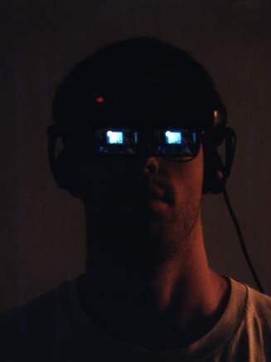

Introductions
Instructor
Blair MacIntyre
blair@cc.gatech.edu
Office Hours:
10:20-11 MW (after class period)
During class period when the lecture is pre-recorded
By appointment
Augmented, Virtual, and Mixed Reality; Games; Graphics; HCI
Professor, CoC/IC; Adjunct Professor, LMC
Recently: 4 years as Principal Research Scientist, Mozilla (2016-2020) working on WebXR and web as open, accessible resource for all
Design of MR/AR experiences (3D in the world), web-based XR, privacy and security of XR
Background in math, CS, 3D graphics
PhD research in distributed interactive 3D software design

Slide 3
Who are your TAs?
Stanley Cantrell (cantrell) | C09: Thursday 03:30 pm-05:25 pm C14: Friday 12:30 pm-02:25 pm
Ezekiel Day (eday30) | C04: Wednesday 05:00 pm-06:55 pm C08: Friday 12:30 pm-02:25 pm
Sanghavi Gaddam (sanghavig) | C03: Wednesday 05:00 pm-06:55 pm C05: Thursday 05:00 pm-06:55 pm
Arvin Goyal (agoyal301) | C11: Friday 05:00 pm-06:55 pm
Nate Knauf (nate.knauf) | C02: Friday 12:30 pm-02:25 pm C10: Friday 03:30 pm-05:25 pm
Vy Le (vy31) | C13: Friday 03:30 pm-05:25 pm
Stephanie Lee (elee463) | C01: Thursday 8:25 am-10:20 am C06: Wednesday 06:30 pm-08:25 pm
Kylie McArthur (kmcarthur3) | C07: Thursday 05:00 pm-06:55 pm C15: Wednesday 06:30 pm-08:25 pm
Jas Pyneni (jpyneni) HEAD TA | C12: Thursday 12:30 pm-02:25 pm
Dhruv Samdani (dsamdani) | C16: Friday 03:30 pm-05:25 pm C17: Thursday 05:00 pm-06:55 pm

Slide 4
Background + one topic or issue about computing and society that interests or concerns you, and why
ì
TA Introduction: Who are your TAs?

Slide 5
By the end of this course, I hope to have learned…?
Take 2 minutes to write out in chat what you hope to learn from this course. In the meanwhile, let’s hear from our TAs!

Slide 6
Course Objectives
Ethics
What do "right" and "wrong" mean anyway?
Professional Ethics
What special responsibilities do we have as computing professionals?
Computing and Society
In what ways does computer technology impact society?
Argumentation
How do you construct a well-reasoned argument?
Notes:
Ethics: We'll learn about several philosophical approaches to ethics, and the end-goal will be for you to fluently apply these frameworks to real-world scenarios on computing and society.
Professional ethics: We’ll also learn about the special responsibilities we have as computing professionals in this increasingly computational world of ours
Computing and society: We’ll think critically about the intersections of computing and society, discussing topics like privacy, intellectual property and freedom of speech
Argumentation: Finally, we’ll learn how to construct and write well-reasoned arguments. Being able to identify what’s right and wrong means little if you can’t articulate ways to create change.

Slide 7
By the end of this course…
How do we protect people’s privacy in face of economic incentives to collect, process and analyze people’s personal data?
How do we empower marginalized communities instead of exploiting them with technology?
How do we continue to trust media in the face of algorithmically created and distributed disinformation?

Slide 8
By the end of this course…
How is a product/project achieving ethical accountability?
How might individuals’ privacy and anonymity be impinged via aggregation and linking of data a product might need?
How do we know that the data is ethically available for its intended use?
How do we know that the data is valid for its intended use?
How transparent does the machine learning model need to be and how is that transparency achieved?
What are likely misinterpretations of the results and what can be done to prevent those misinterpretations?

Slide 9

Differences of Opinion
We each represent different views, and bring with us different perspectives
It’s always OK to challenge someone’s views
Must be able to explain why you believe what you believe
Acceptable to say: “I don’t know. I need to think about it more.”
Always be respectful
Someone with different views is interesting. Try to understand them!

Slide 10
Discussion: The Stop Sign
You are driving out in the desert. You can see in all directions for miles. No one else is around. You see a stop sign. Do you stop? Why or why not?
Answer the poll and write out why in chat.
Notes:
Let’s start with our first group discussion!

Slide 11
Logistics
Course webpage & syllabus: https://blairmacintyre.me/cs4873-s21
Canvas for announcements, Perusall, and homework submissions
Videos and (most) readings in Perusall
You’ll go over the webpage in more detail in your recitation
Notes:
Ask before advancing: What is ethics?

Slide 12
What does ”remote synchronous” mean?
We have a class time, which guarantees we can meet together; attendance will not be required at lectures (after this one)
Most lectures will be pre-recorded
Mondays: instructor available to meet in Teams
Wednesdays: instructor and TAs available to meet in Teams
This is the first time I’ve taught this course, so there will be some experimentation. Thanks for understanding!
No exams; instead, weekly quizzes and reading commentaries
Notes:
In-class: some lectures, but lots of in-class discussion.

Slide 13
Course Structure
50-minute lectures twice a week:
M/W 9:30-11:20
Virtually via Teams for now
2-hour recitations once a week
Run by one of your TAs
Attendance mandatory
Virtually via BlueJeans or Teams (TA will tell you where/how to meet via Canvas for your section)
Recitations start TODAY
Topic schedules on course webpage (may change)
Notes:
Much of this opportunity for growth and development will occur through your willingness to speak and engage. The ethical frameworks we cover in this class will provide you with tools to address ethical dilemmas you may encounter in your professional lives, but ethics is a social sensemaking activity.
Be part of the conversation.

Slide 14
Grading
 | % of final grade
Reading Commentaries | 10
Quizzes | 10
Recitation participation | 25
Homeworks | 25
Term paper | 25
Term paper presentation | 5

Slide 15
Reading commentaries
https://blairmacintyre.me/cs4873-s21-homeworks#reading-commentaries
Each week, you will write a commentary for one or more of the required assigned reading (there are no more than three per week). The details will be specified on an assignment on canvas
Each reading commentary should be a short paragraph (~4 sentences) and should end with a question or discussion prompt, related to the reading, that you would like to talk about.
Due an hour before class on Canvas.

Slide 16
Required text
Ethics for the Information Age*, Seventh Edition or above, by Michael Quinn
Articles accessed through GT library and GT VPN.
Articles available online.
I will put many inside Perusall on Canvas
* (You may rent an electronic copy rather than buying it.)

Slide 17
“A branch of philosophy that involves systematizing, defending and recommending concepts of right and wrong conduct.”
- Anonymous Wikipedia contributors
What is ethics?
Notes:
Sometimes, what’s right and wrong is clear and intuitive. Other times, it’s not so clear cut. Ethics attempts to formalize
our intuitions of what’s right and wrong so that we can make rational arguments about if someone’s actions were “right”
or “wrong”. Unpacking right and wrong is often more complicated than it seems.
Ask volunteers: How would you define what is right and what is wrong?

Slide 18
Diﬀerence between legal and ethical
Laws formalize what people can and cannot do in society, while ethics are moral standards that govern what people should or should not do
In some instances, legal regulations prohibit people from carrying out certain tasks, such as administering life-saving support, that would generally be considered morally permissible actions.
This isn’t to say legal and ethical are always distinct.

Slide 19
What are some historic example of actions that were illegal at one time, but that are now largely considered ethical?
How about actions that were considered legal at one time, but are now considered unethical?
ì
Legal vs Ethical
Notes:
Let’s stay away from some present day debates such as medical marijuana usage,
just so that the conversation doesn’t get too far away from the broader point of
trying to understand the difference between what is legal and what is ethical.
Illegal but ethical:
- Civil disobedience --> an example of a situation where the individual
feels that disobeying the law is the only ethical choice
Legal but unethical:
Slavery
Human sacrifices

Slide 20
Diﬀerence between legal and ethical
Some laws generate few negative responses, as their intent to protect and promote the safety and well-being of the public is virtually indisputable.
Other laws, however, generate disagreement among citizens.
While legal and moral issues sometimes coexist in harmony, they can also raise questions and generate conﬂicting opinions.
Theory and practice of law can also differ in ethical or moral standing.
Notes:
end-of-life care, medical treatment for addiction, etc.
Laws are usually an attempt to crystallize the moral compass of a society at any given moment, but often lag behind.

Slide 21
What special responsibilities do we have as computing professionals?
Write out your thoughts in chat!
Professional Ethics
Notes:
Computing intersects with society in so many ways.
Self-driving cars
Privacy and data collection
Intellectual property
Fake news
Algorithmic curation of news
Control of medical robots

Slide 22
Some Examples We May Consider in the Class Going Forward
Algorithmic bias
Amazon’s hiring tool
Privacy
“Always on” Internet of Things (IoT) devices
Governmental surveillance
Public surveillance in China
Behavioral prediction markets and programming
The Facebook emotion contagion study

Slide 23
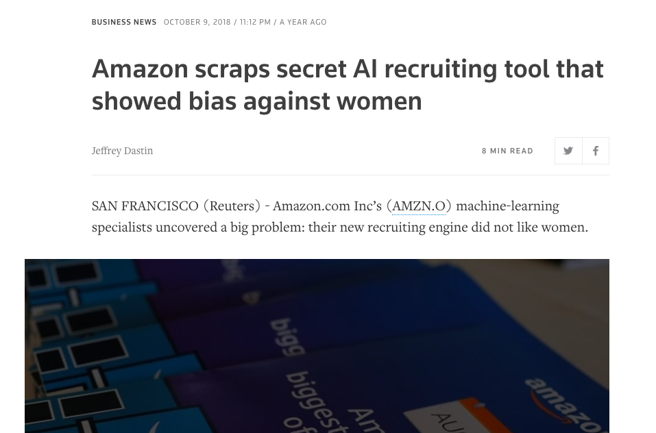

Slide 24
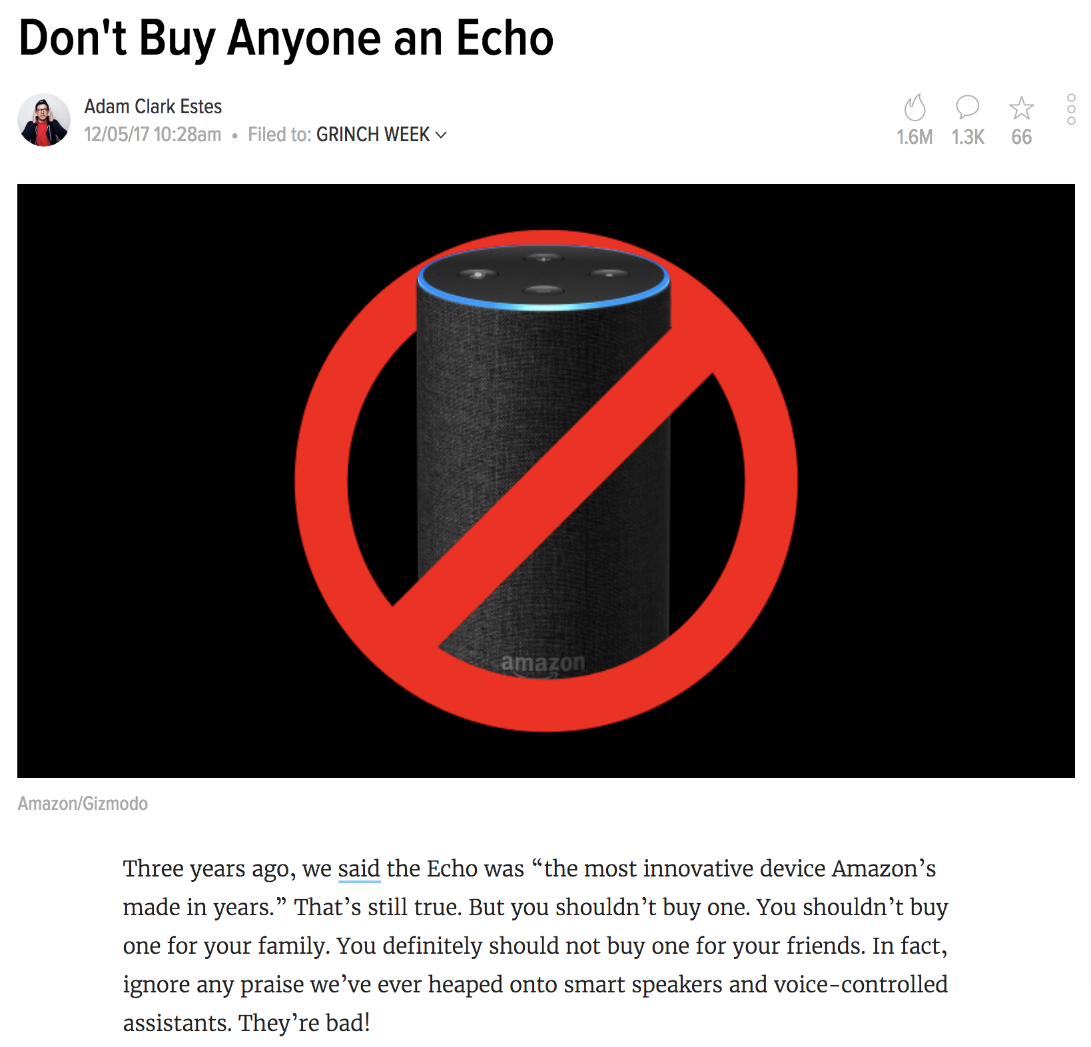

Slide 25
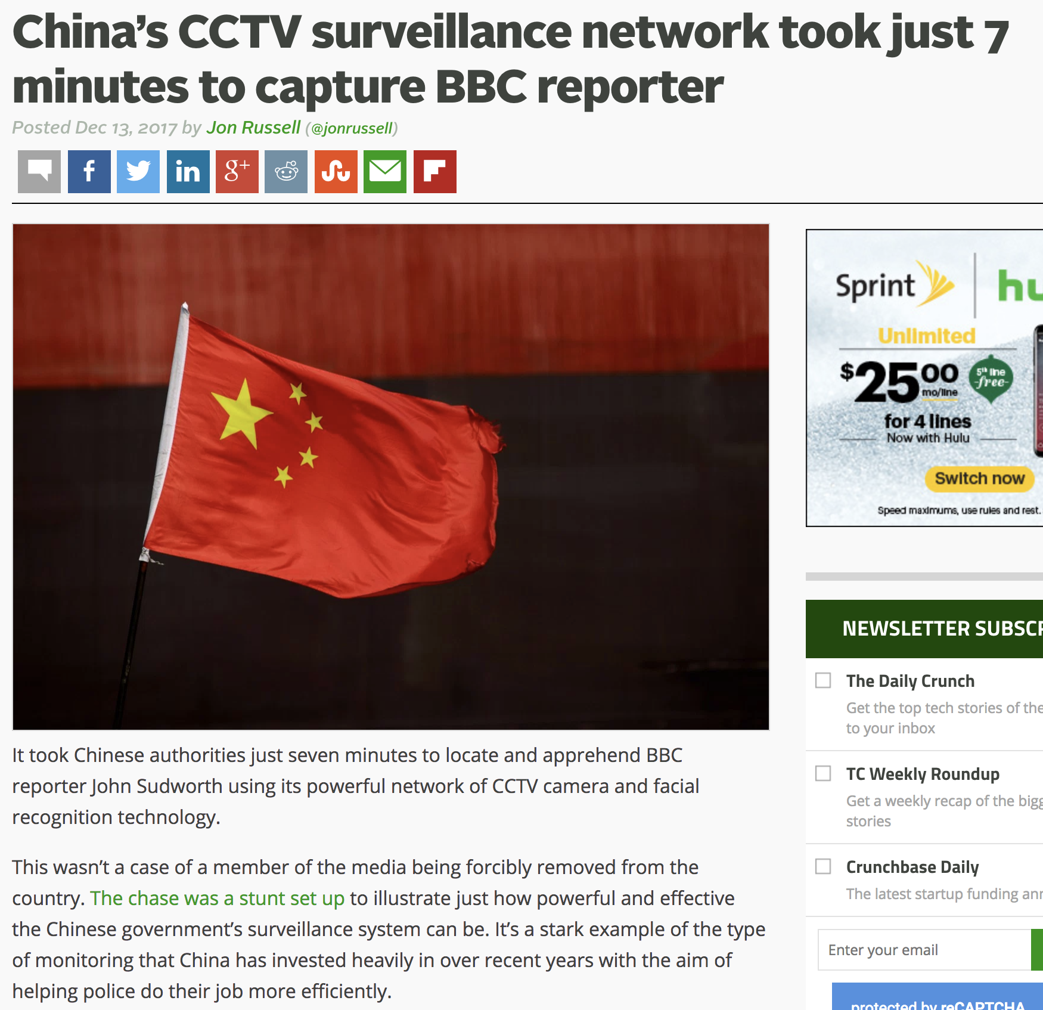

Slide 26
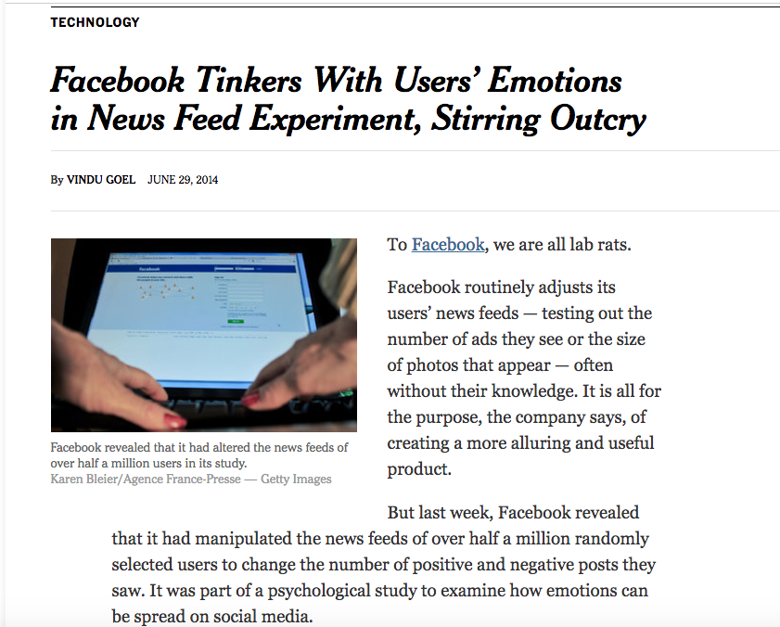

Slide 27
Discussion Session This Week
Link to discussion guide on website
Please read it and come prepared!
This week will be shorter than normal
Introductions and discussion of expectations (ours, and yours!)

Slide 28
Reading for Next Week
Monday
Reading
”Medical Devices: The Therac-25” by Nancy Leveson
Quinn 8.5
Optional readings
NYT article
“Incident reporting and learning in radiation oncology”
Think about the people
What did they do?
What should they have done?
What pressures are they under?
Wednesday
Reading
Let’s get writing
Historical Perspectives on Argumentation. 3 sections: Classical, Toulmin, Rogerian

Slide 29
First Assignment
Therac and the Boeing 737 Max
Due Feb 1st

Slide 30
Questions?
Reminder: Sections meet starting TODAY!

